Slide 1
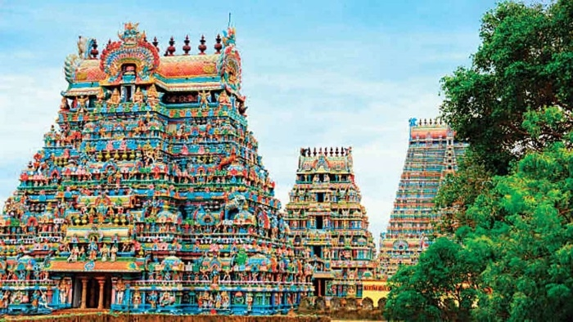
Preservation of Historic Temples in Tamil Nadu
STUDENT:
Jayapriya Muthuramasamy,
20461
PROFESSOR:
Dr. Bhaskar Vidhyacharan

Slide 2

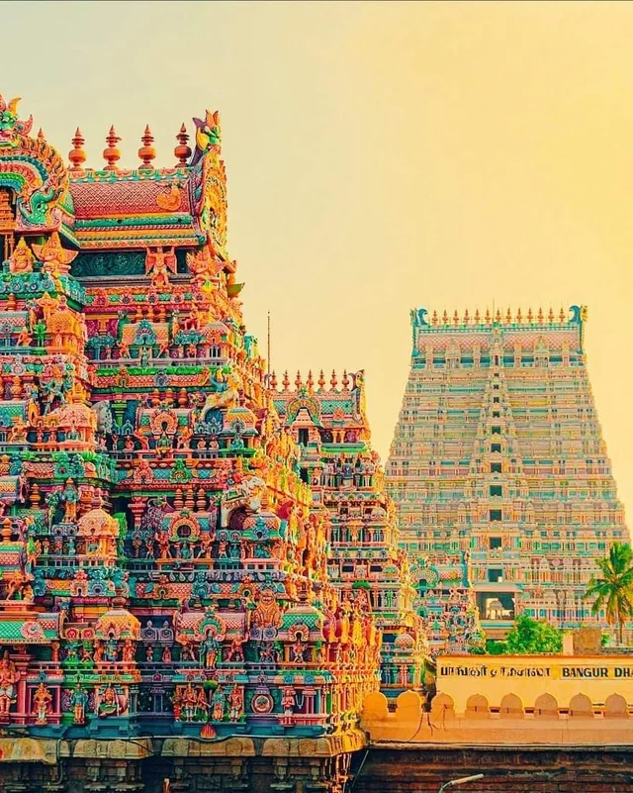
Table of Content
Introduction
Problem and Solution
ER Diagram
Entities and Attributes
Relationships
Tables Display
SQL Commands
Mathematical Notations
Conclusion
References

Slide 3
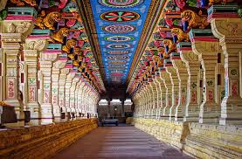
Introduction
Tamil Nadu is well known for its historic temples, which serve as symbols of the rich history, culture, and architectural design of the area.
Due to negligence, weather-related damage, pollution, and improper maintenance, many of these temples are currently in danger.
Preservation efforts are complicated by the fact that existing documents are frequently dispersed, out-of-date, or badly kept.
In order to facilitate efficient planning for conservation and repair, this project presents a digital system for centralizing temple data.

Slide 4
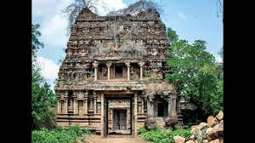
Problem Statement
Most of the ancient temples in Tamil Nadu are in decline due to environmental damage, lack of attention, and insufficient documentation.
The current system for managing temples lacks a detailed and centralized way to track temple conditions and restoration activities.

Slide 5

Solution
In the proposed database, Real-time information on temple conditions, such as environmental hazards and structural health, will be tracked and centralized.
It will assist in monitoring and managing restoration projects, ensuring that work is planned, completed on schedule, and within budget.
Also, The system will allow stakeholders to submit reports, images, and insights in order to improve cooperation and decision-making for temple conservation.

Slide 6
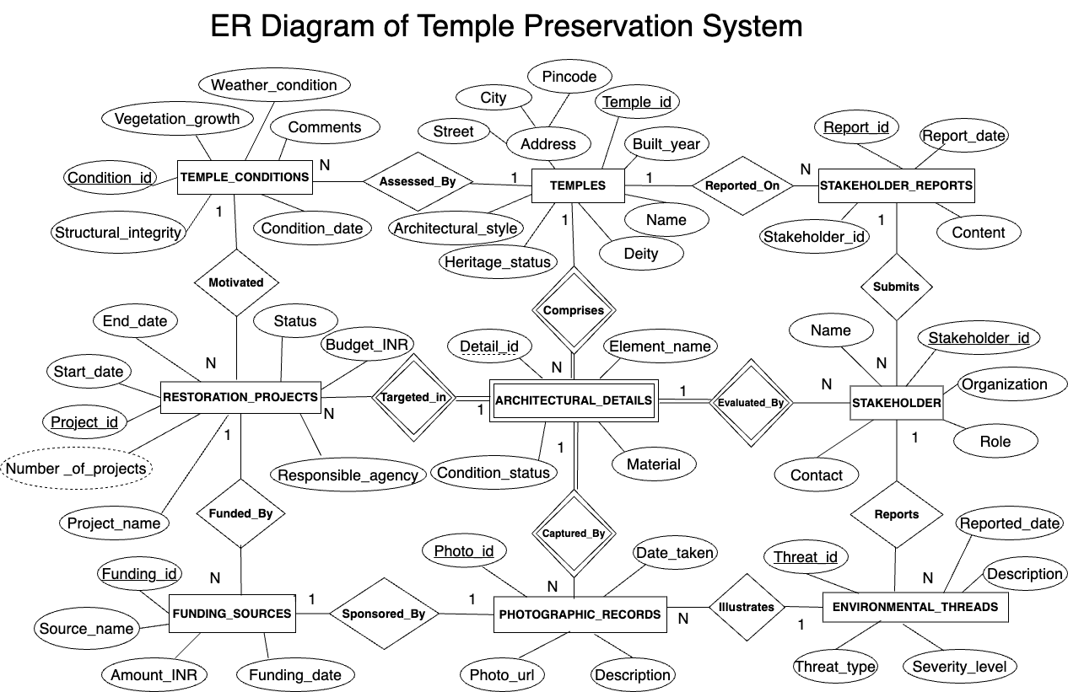
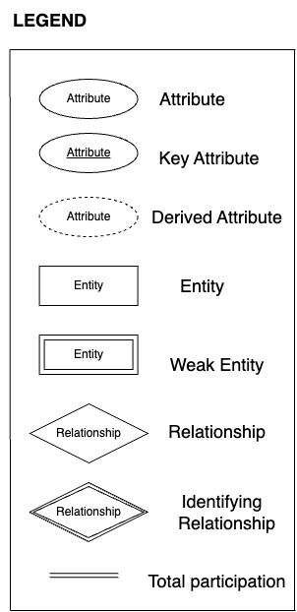

Slide 7
Entities and Attributes
Temples: Temple_id, Name, Street, City, Pincode, Built_year, Architectural_style, Deity, Heritage_status.
Temple_Conditions: Condition_id, Condition_date, Structural_integrity, Weather_condition, Vegetation_growth, Comments.
Restoration_Projects:Project_id, Project_name, Start_date, End_date, Status, Responsible_agency, Budget_INR.
Architectural_Details: Detail_id, Element_name, Material, Condition_status.
Stakeholders: Stakeholder_id, Name, Role, Organization, Contact.
Stakeholder_Reports: Report_id, Report_date, Content.
Photographic_Records: Photo_id, Photo_url, Description, Date_taken.
Funding_Sources:Funding_id, Source_name, Amount_INR, Funding_date.
Environmental_Threats: Threat_id, Threat_type, Severity_level, Description, Reported_date.

Slide 8
Relationships
1. TEMPLES — Assessed_By — TEMPLE_CONDITIONS
A temple (1) can have many condition assessments (N).
2. TEMPLE_CONDITIONS — Motivated — RESTORATION_PROJECTS
A temple condition (1) can motivate many restoration projects (N).
3. RESTORATION_PROJECTS — Funded_By — FUNDING_SOURCES
A restoration project (1) can be funded by many funding sources (N).
4. TEMPLES — Comprises — ARCHITECTURAL_DETAILS
A temple (1) can comprise many architectural details (N).
5. ARCHITECTURAL_DETAILS — Evaluated_By — STAKEHOLDER
A stakeholder (1) can evaluate many architectural details (N).

Slide 9
Relationships
6. STAKEHOLDER — Submits — STAKEHOLDER_REPORTS
A stakeholder (1) can submit many reports (N).
7. STAKEHOLDER — Reports — ENVIRONMENTAL_THREADS
A stakeholder (1) can report many environmental threats (N).
8. ENVIRONMENTAL_THREADS — Illustrates — PHOTOGRAPHIC_RECORDS
An environmental threat (1) can be illustrated by many photographic records (N).
9. PHOTOGRAPHIC_RECORDS — Captured_By — STAKEHOLDER
A photographic record (1) is captured by exactly one stakeholder.
10. RESTORATION_PROJECTS — Targeted_In — ARCHITECTURAL_DETAILS
A restoration project (1) can target many architectural details (N).

Slide 10
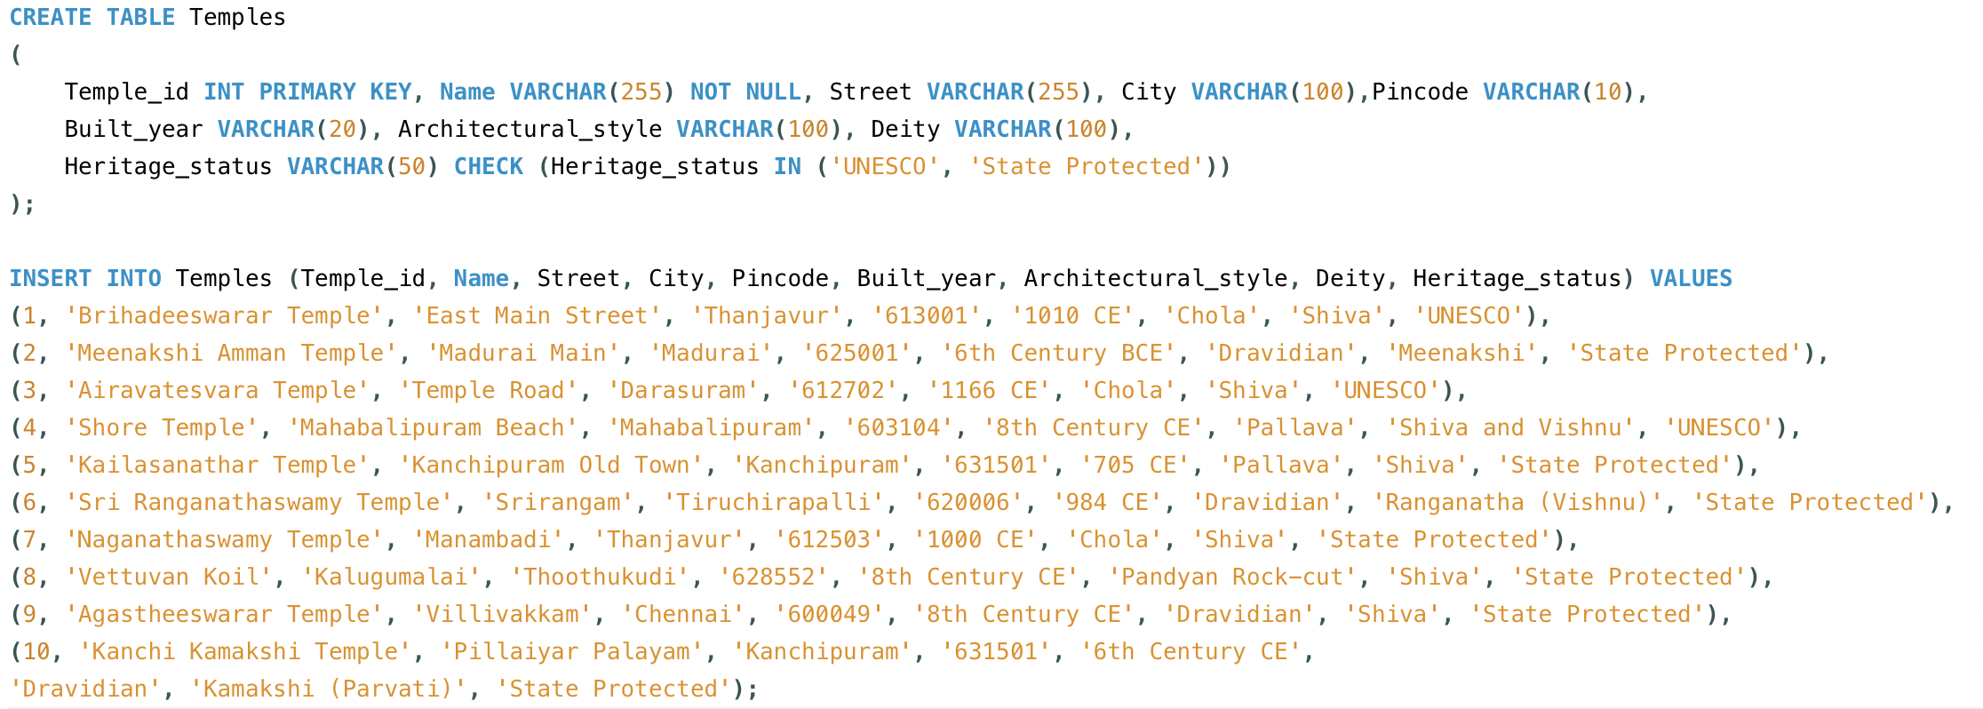
Temples Table

Slide 11
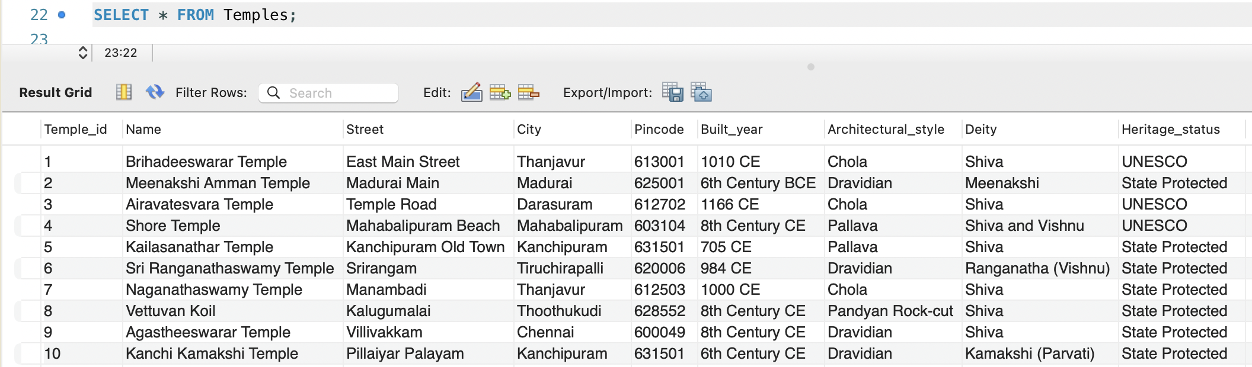
Temples Table Output

Slide 12
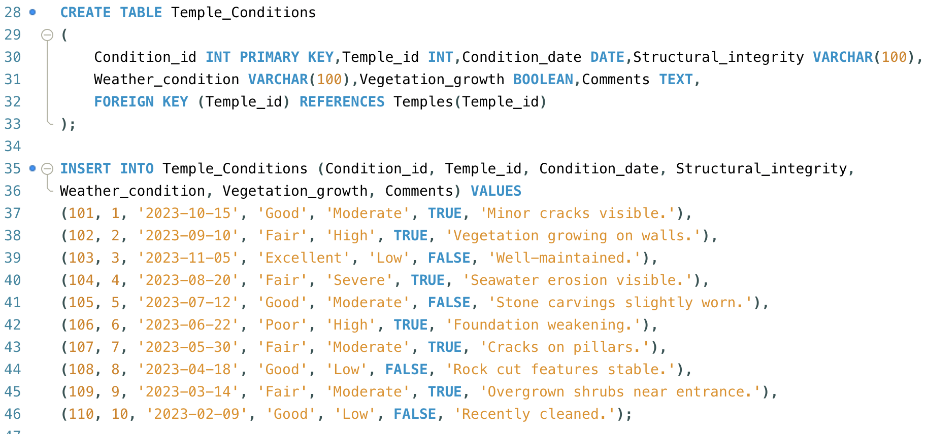
Temple_Conditions Table

Slide 13
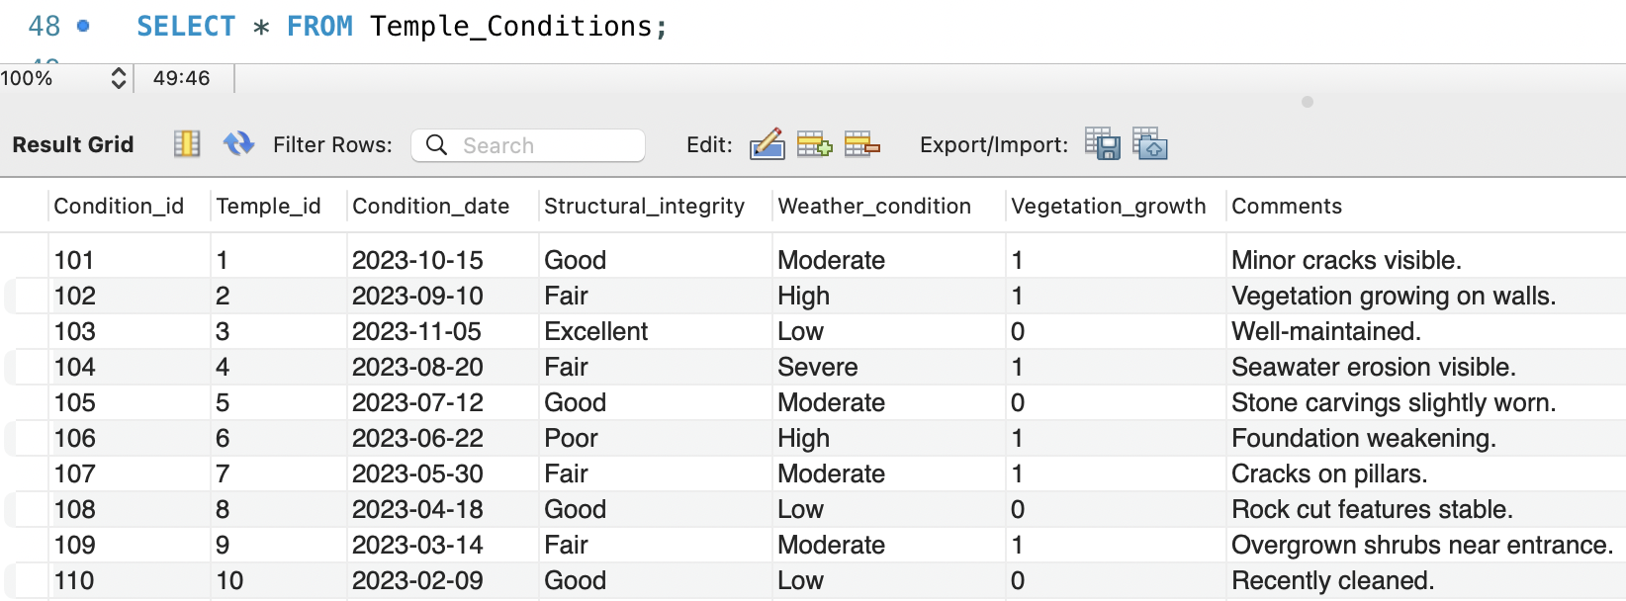
Temple_Conditions Table Output

Slide 14
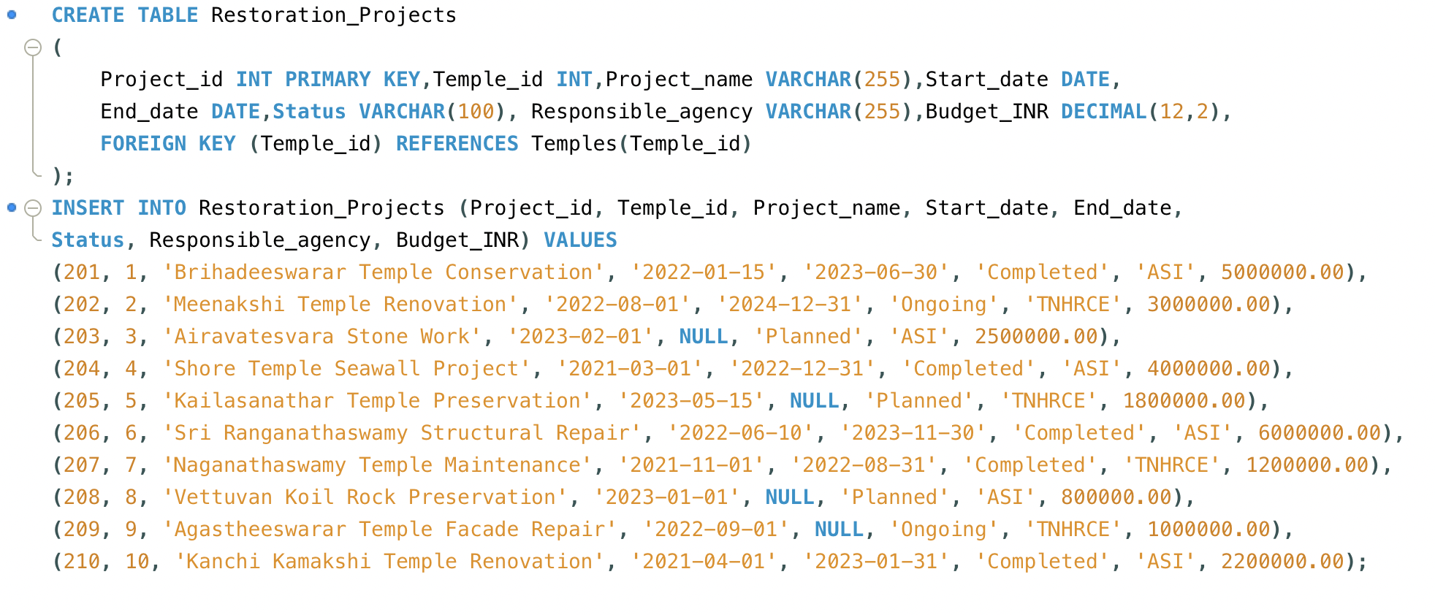
Restoration_Projects Table

Slide 15
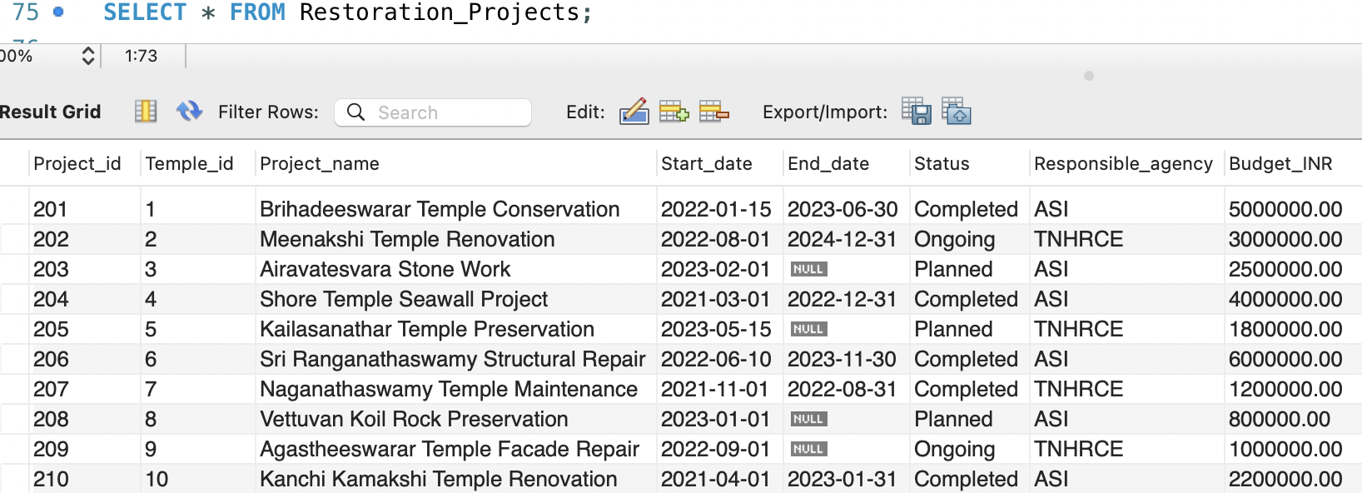
Restoration_Projects Table Output
TNHRCE- Tamil Nadu Hindu Religious and Charitable Endowments Department (HRCE).
ASI- Archaeological Survey of India.

Slide 16
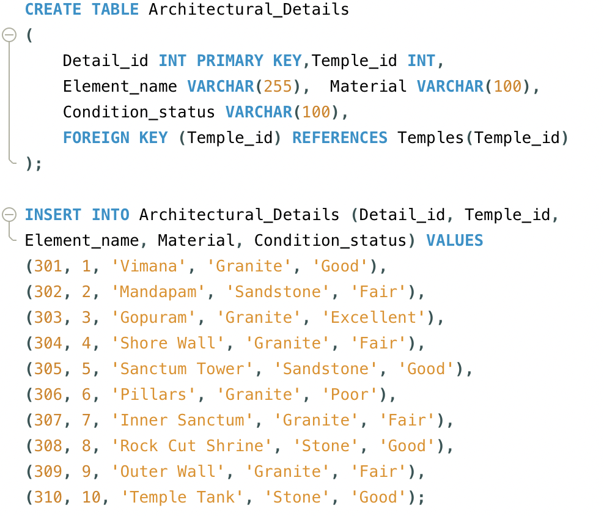
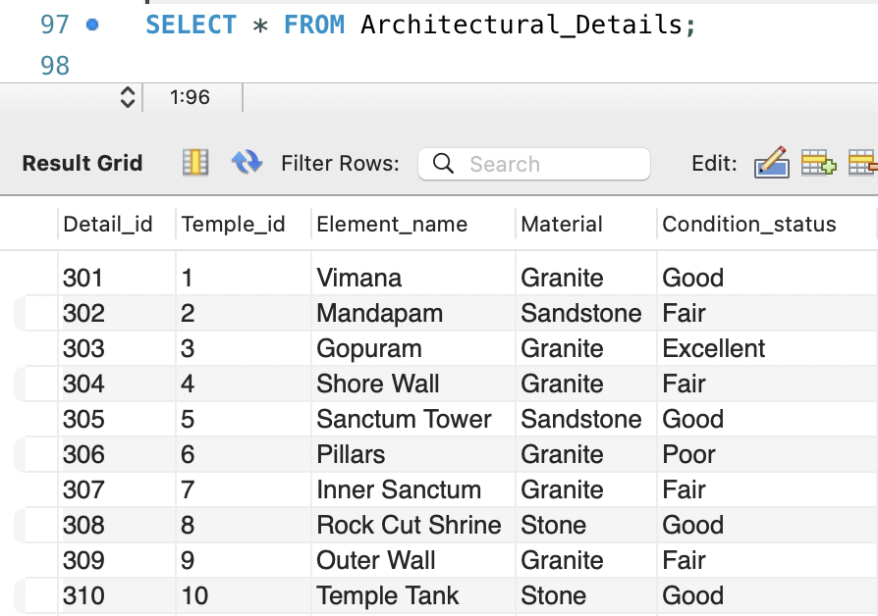
Architectural_Details Table and its output

Slide 17
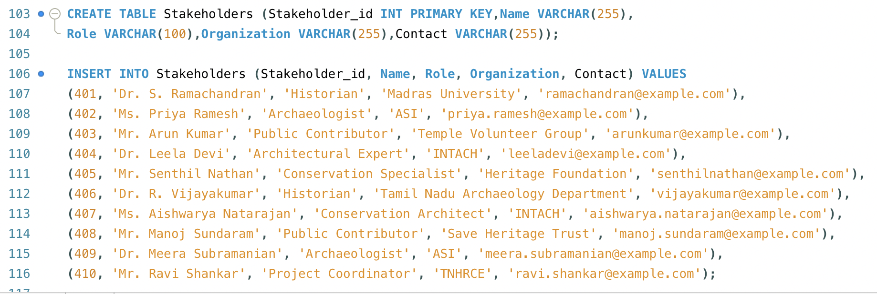
Stakeholders Table

Slide 18
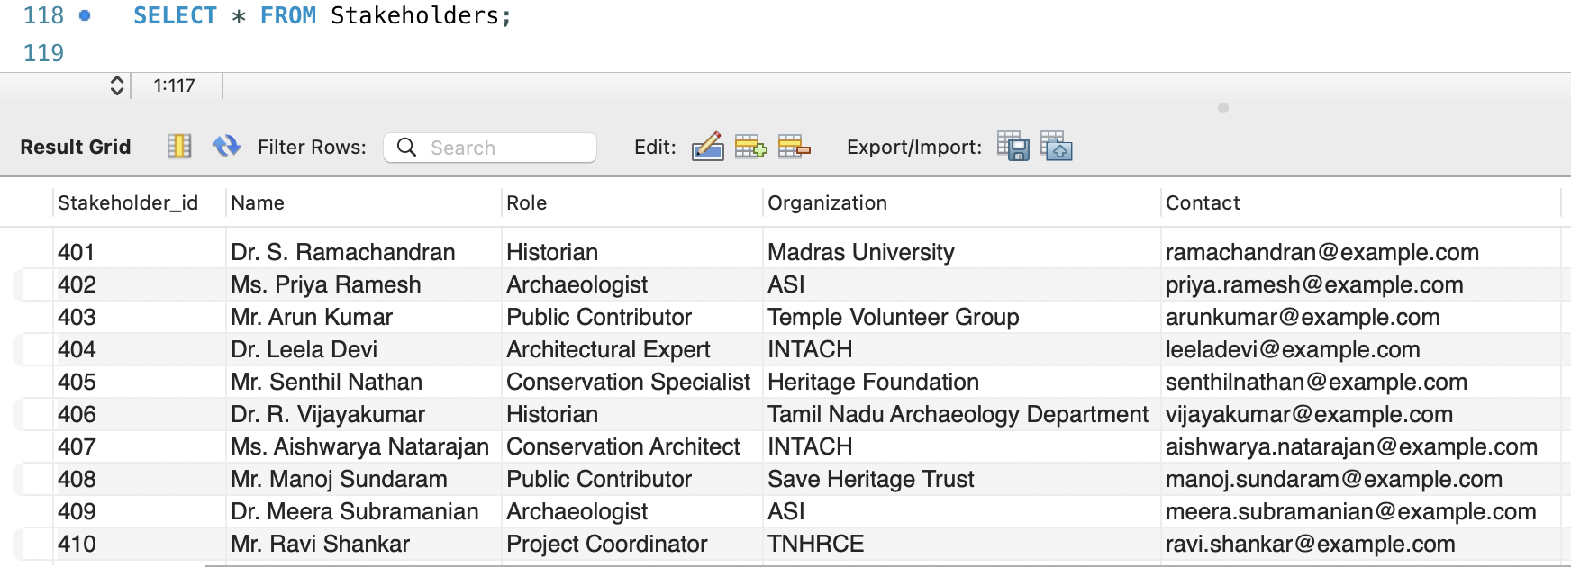
Stakeholders Table Output

Slide 19
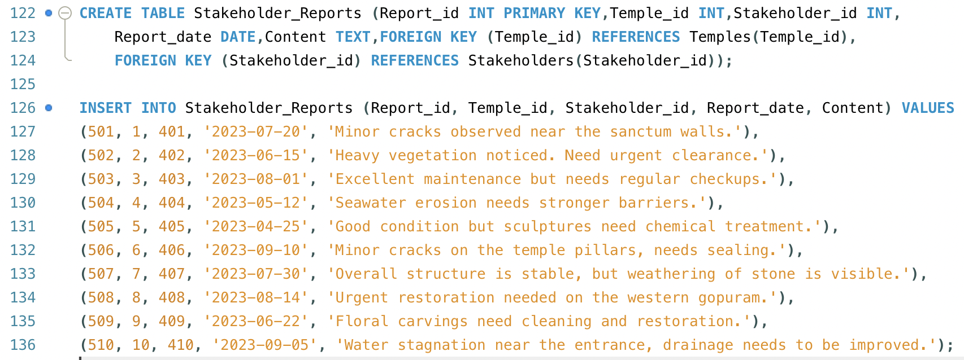
Stakeholder_Reports Table

Slide 20
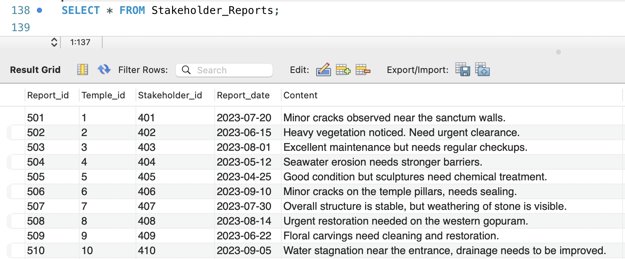
Stakeholder_Reports Table Output

Slide 21
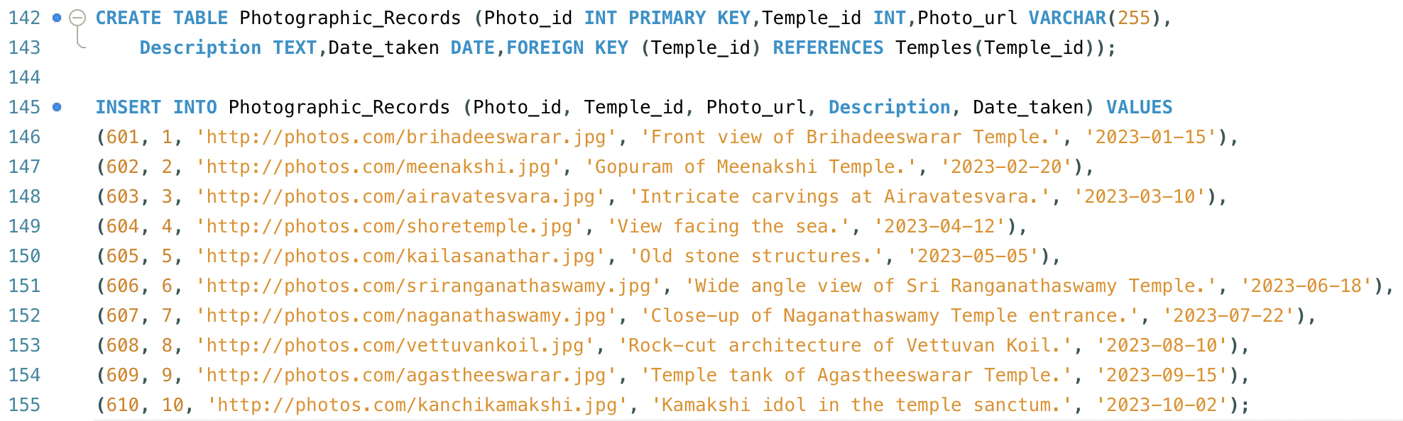
Photographic_Records Table

Slide 22
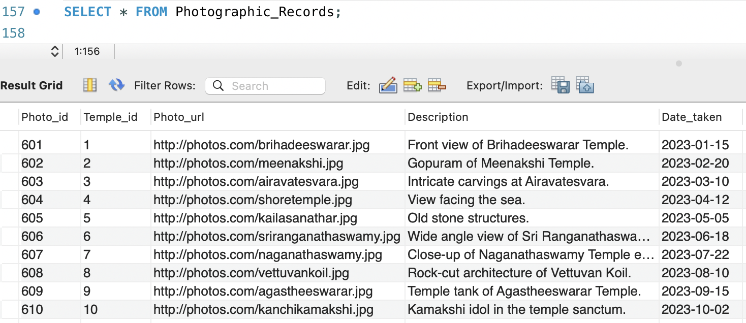
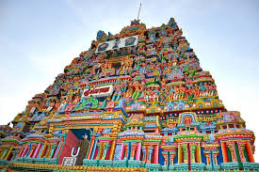
Photographic_Records Table Output

Slide 23
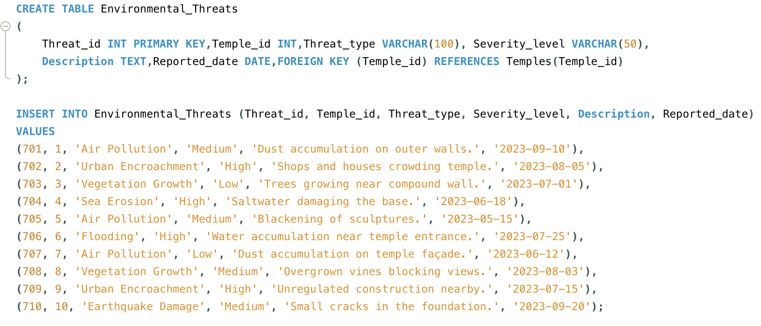
Environmental_Threats Table

Slide 24
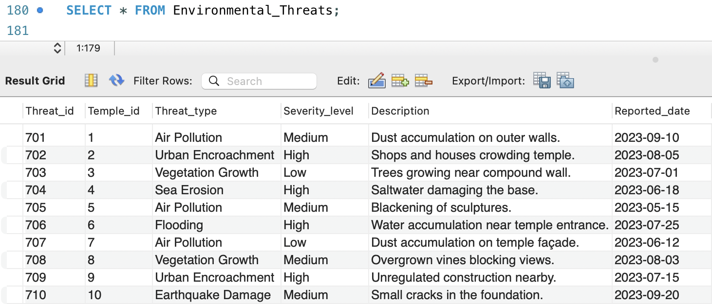
Environmental_Threats Table Output

Slide 25
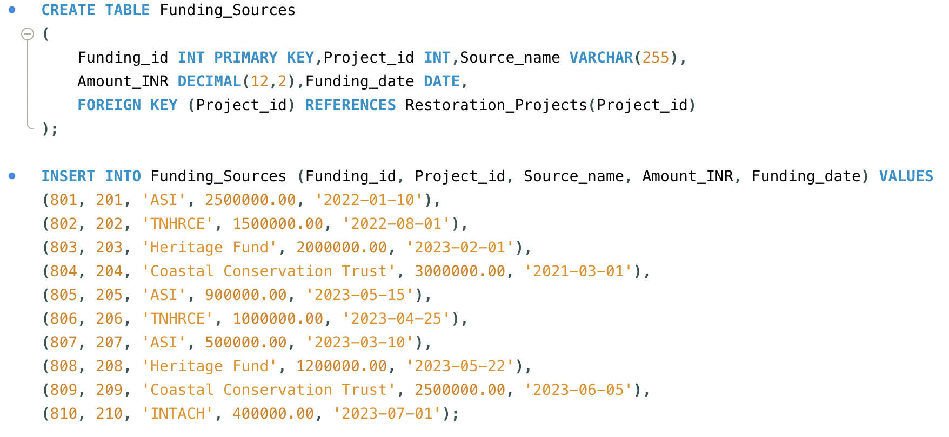
Funding_Sources Table

Slide 26
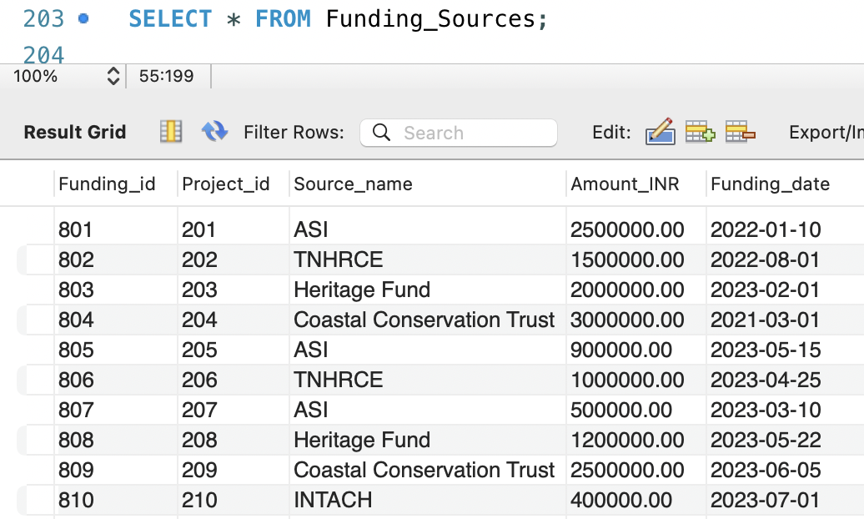

Funding_Sources Table Output
26

Slide 27
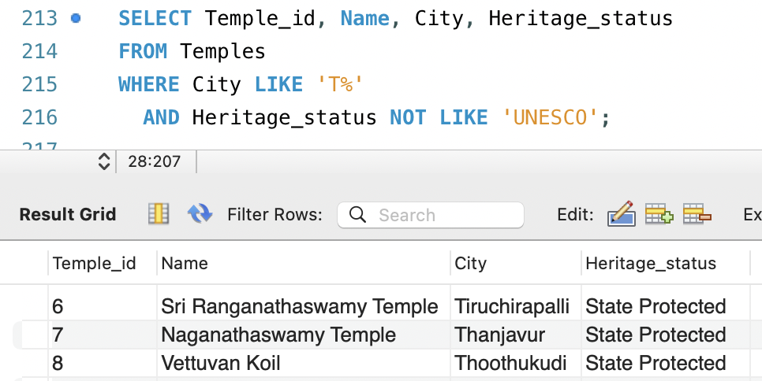
Basic SQL Queries
Lists the temples data that start with “T” in their city name but not UNESCO heritage.
SELECT Temple_id, Name, City, Heritage_status
FROM Temples
WHERE City LIKE 'T%'
AND Heritage_status NOT LIKE 'UNESCO’;
Explanation:
This query selects temple details where the city name starts with 'T' and the temple is not a part UNESCO heritage site.

Slide 28
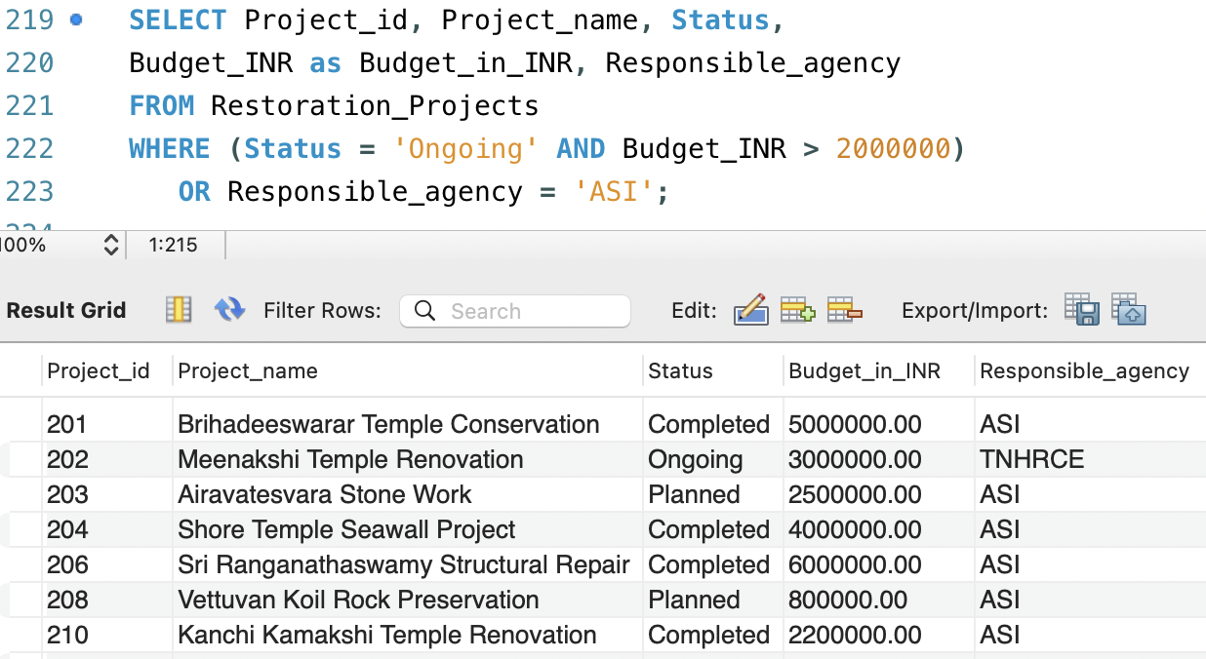
Basic SQL Queries
2. List the projects that are ongoing with a high budget of over 2000000 INR or funded by ASI.
SELECT Project_id, Project_name, Status,
Budget_INR as Budget_in_INR, Responsible_agency
FROM Restoration_Projects
WHERE (Status = 'Ongoing' AND Budget_INR > 2000000)
OR Responsible_agency = 'ASI’;
Explanation:
This query gets the project details for restoration projects that are either ongoing with a budget over 20 lakh INR or are handled by the ASI (Archaeological Survey of India).

Slide 29
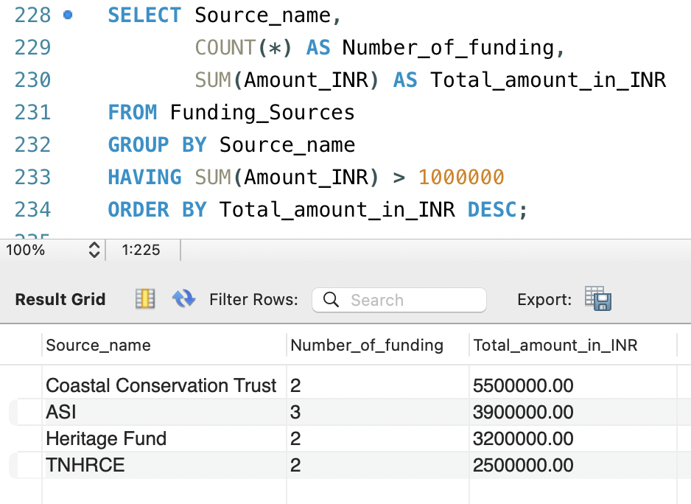
Basic SQL Queries
3. Lists the funding sources with the total contributions over 1,000,000 INR in descending order.
SELECT Source_name,
COUNT(*) AS Number_of_funding,
SUM(Amount_INR) AS Total_amount_in_INR
FROM Funding_Sources
GROUP BY Source_name
HAVING SUM(Amount_INR) > 1000000
ORDER BY Total_amount_in_INR DESC;
Explanation:
This query fetches the name of the funding sources that contribute over 10 lakh INR, along with how many times they funded and their total amount , sorted by highest amount first.

Slide 30
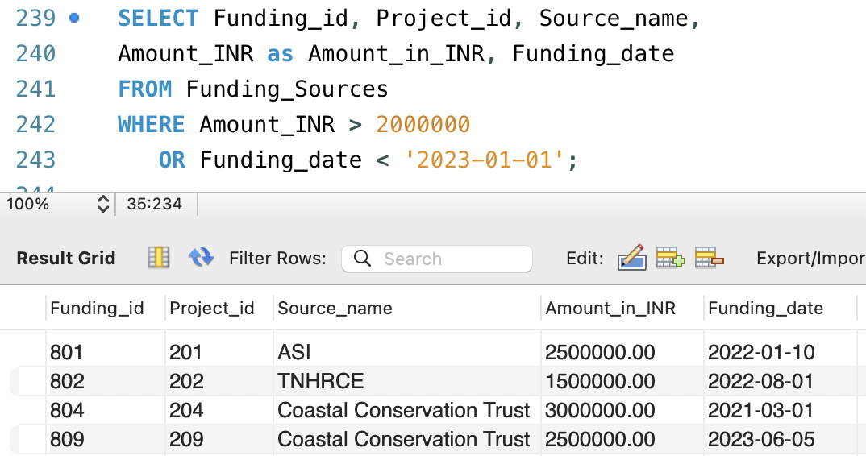
Basic SQL Queries
4. Lists the funding sources after 2023-01-01 and with amounts greater than 2,000,000 INR.
SELECT Funding_id, Project_id, Source_name,
Amount_INR as Amount_in_INR, Funding_date
FROM Funding_Sources
WHERE Amount_INR > 2000000
OR Funding_date < '2023-01-01’;
Explanation:
This query retrieves funding details such as Funding ID, Project ID, Source Name, Funding Amount and its Date where the amount is greater than 20 lakh INR or the funding date is before January 1, 2023.

Slide 31
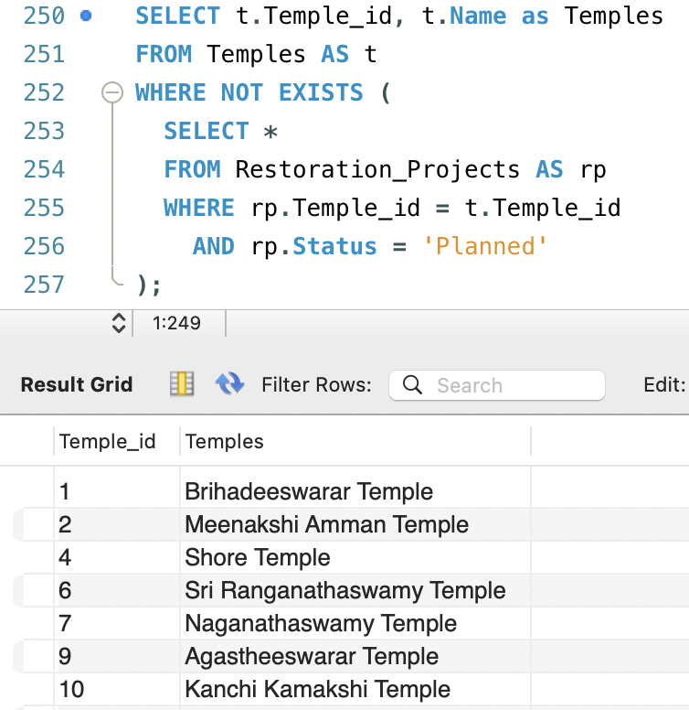
Basic SQL Queries
5. List the temples that have no 'Planned' restoration projects.
SELECT t.Temple_id, t.Name as Temples
FROM Temples AS t
WHERE NOT EXISTS (
SELECT *
FROM Restoration_Projects AS rp
WHERE rp.Temple_id = t.Temple_id
AND rp.Status = 'Planned’
);
Explanation:
This query shows the IDs and names of temples that do not have any 'Planned' restoration projects associated with them.

Slide 32
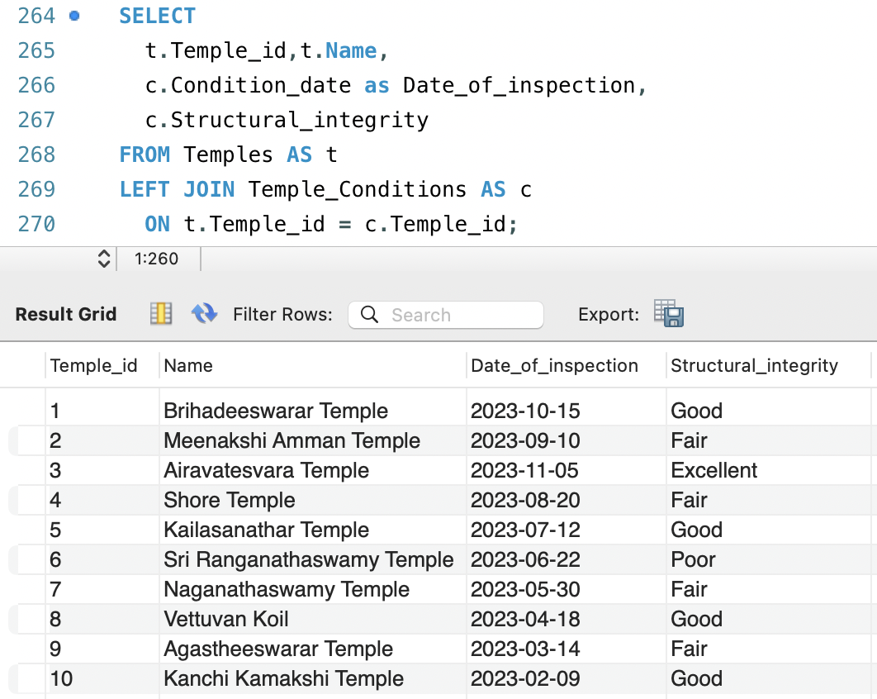
Intermediate SQL Queries
List all the temples and show the temple's condition assessments with the date of inspection.
SELECT
t.Temple_id,t.Name,
c.Condition_date as Date_of_inspection,
c.Structural_integrity
FROM Temples AS t
LEFT JOIN Temple_Conditions AS c
ON t.Temple_id = c.Temple_id;
Explanation:
This query lists all temple names along with their inspection date and structural condition. It uses a LEFT JOIN to include all the temple name from left table, give the matching data from Temple_Conditions table.

Slide 33
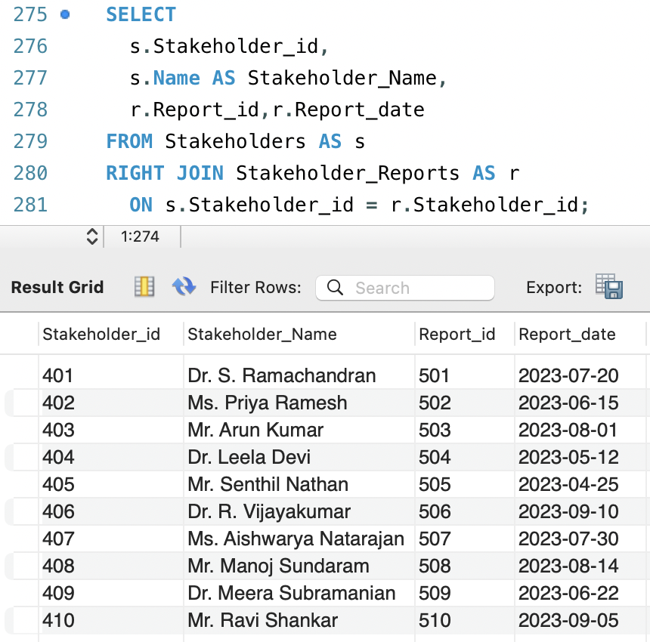
Intermediate SQL Queries
2. List the name of all stakeholders and the reports submitted by them.(including those with no reports).
SELECT
s.Stakeholder_id,
s.Name AS Stakeholder_Name,
r.Report_id,r.Report_date
FROM Stakeholders AS s
RIGHT JOIN Stakeholder_Reports AS r
ON s.Stakeholder_id = r.Stakeholder_id;
Explanation:
This query lists all report IDs and dates along with the stakeholder names who submitted them. It uses a RIGHT JOIN to include all the report data from the right table and gives the matching stakeholder name from the Stakeholders table.

Slide 34
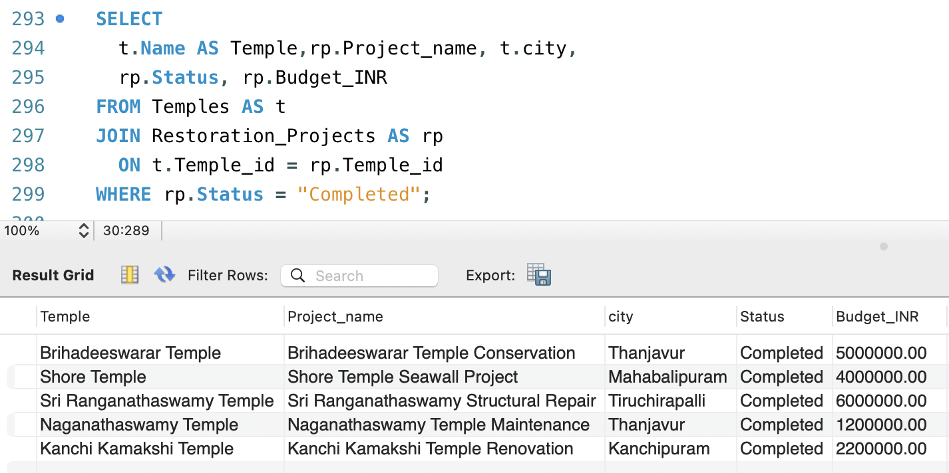
Intermediate SQL Queries
3. List the temples that have at least one completed restoration project, along with its project’s details.
SELECT
t.Name AS Temple,rp.Project_name, t.city,
rp.Status, rp.Budget_INR
FROM Temples AS t
JOIN Restoration_Projects AS rp
ON t.Temple_id = rp.Temple_id
WHERE rp.Status = 'Completed’;
Explanation:
This query lists temple names along with the names, status, and budgets of their completed restoration projects. It uses an INNER JOIN to match temples with their projects using Temple_id, and filters the data where the project status is 'Completed'.

Slide 35
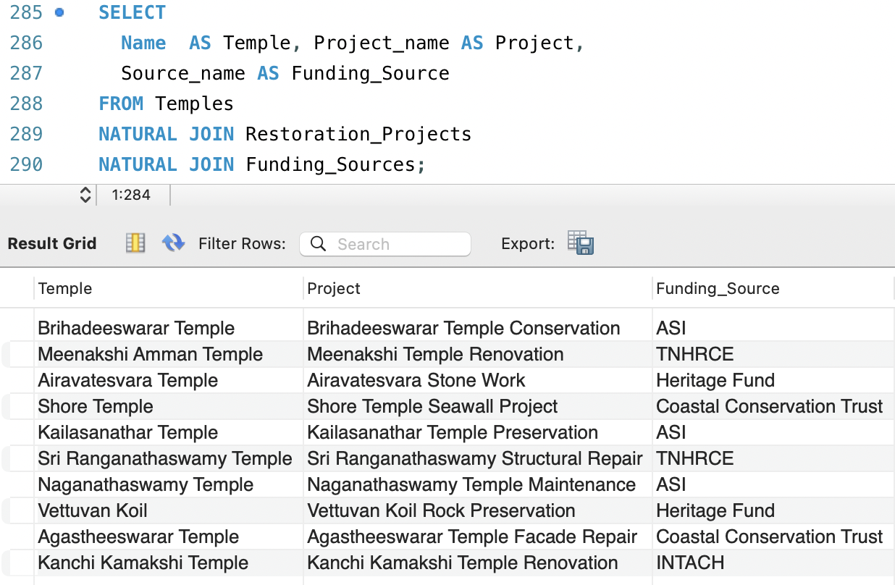
Intermediate SQL Queries
4. List the name of all temples, its restoration project, and funding source of the projects.
SELECT
Name AS Temple, Project_name AS Project,
Source_name AS Funding_Source
FROM Temples
NATURAL JOIN Restoration_Projects
NATURAL JOIN Funding_Sources;
Explanation:
This query lists temple names, their restoration project names, and the funding sources. It uses NATURAL JOINs to automatically match and join tables using columns with the same names in all three tables (e.g., Temple_id, Project_id).

Slide 36
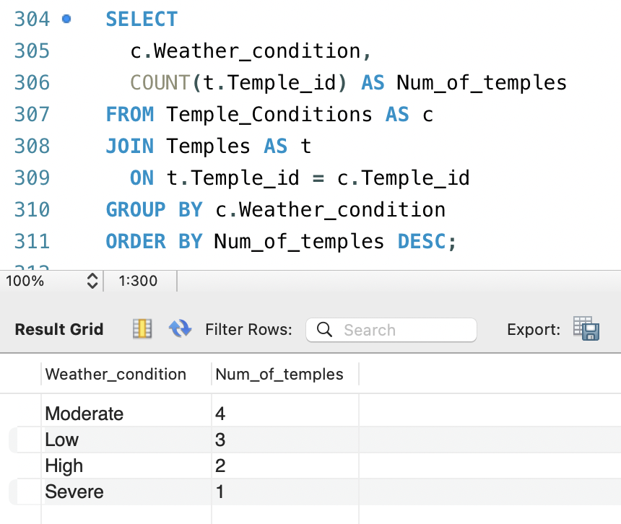
Intermediate SQL Queries
5. Count how many temples have each weathering level, ordered by the count descending.
SELECT
c.Weather_conditions,
COUNT(t.Temple_id) AS Num_of_temples
FROM Temple_Conditions AS c
JOIN Temples AS t
ON t.Temple_id = c.Temple_id
GROUP BY c.Weather.conditions
ORDER BY Num_of_temples DESC;
Explanation:
This query counts the number of temples at each weather condition by JOINING two table on Temple_id and then grouping them by the condition and sorting the results in descending order.

Slide 37
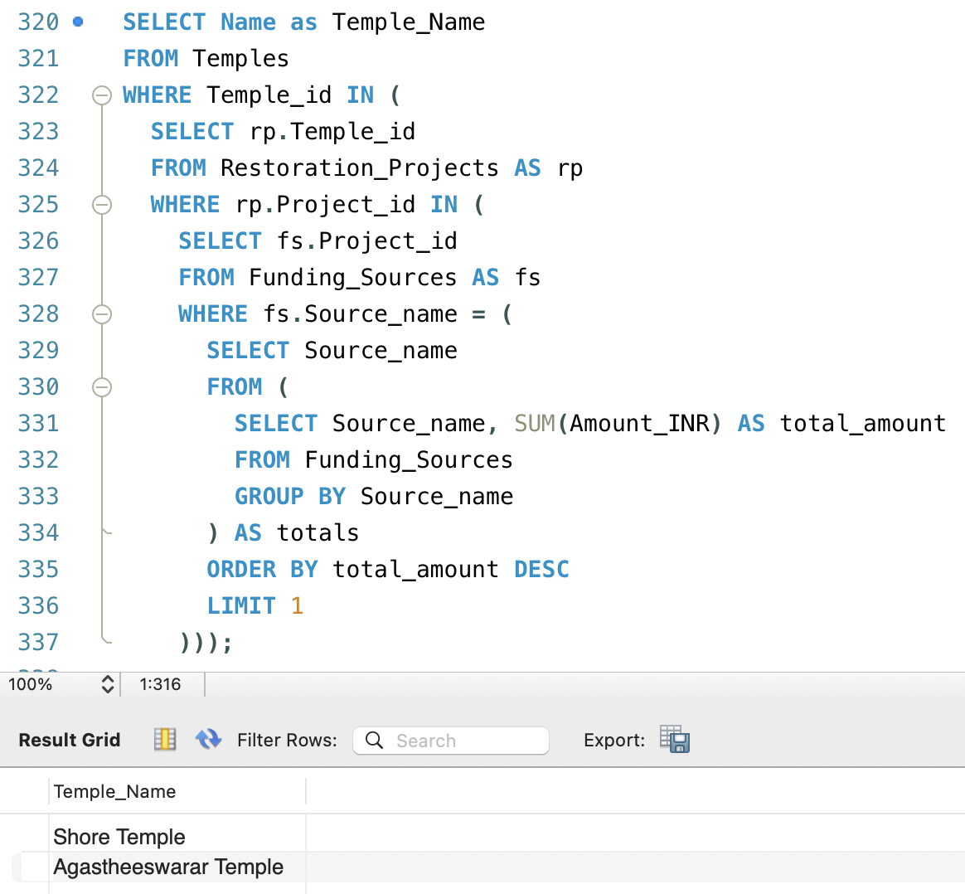
Advanced SQL Queries
Find temples funded by the single top‐contributing source (the one whose sum of amounts is highest).
SELECT Name
FROM Temples
WHERE Temple_id IN (
SELECT rp.Temple_id
FROM Restoration_Projects AS rp
WHERE rp.Project_id IN (
SELECT fs.Project_id
FROM Funding_Sources AS fs
WHERE fs.Source_name = (
SELECT Source_name
FROM (
SELECT Source_name, SUM(Amount_INR) AS total_amount
FROM Funding_Sources
GROUP BY Source_name
) AS totals
ORDER BY total_amount DESC
LIMIT 1) ) );
Explanation:
Innermost subquery calculates the total amount for each funding source. Second subquery picks the funding source with the highest total amount. Third subquery finds the temples having projects funded by the largest source. Outer query retrieves the names of the temples from the outer Temples table.

Slide 38
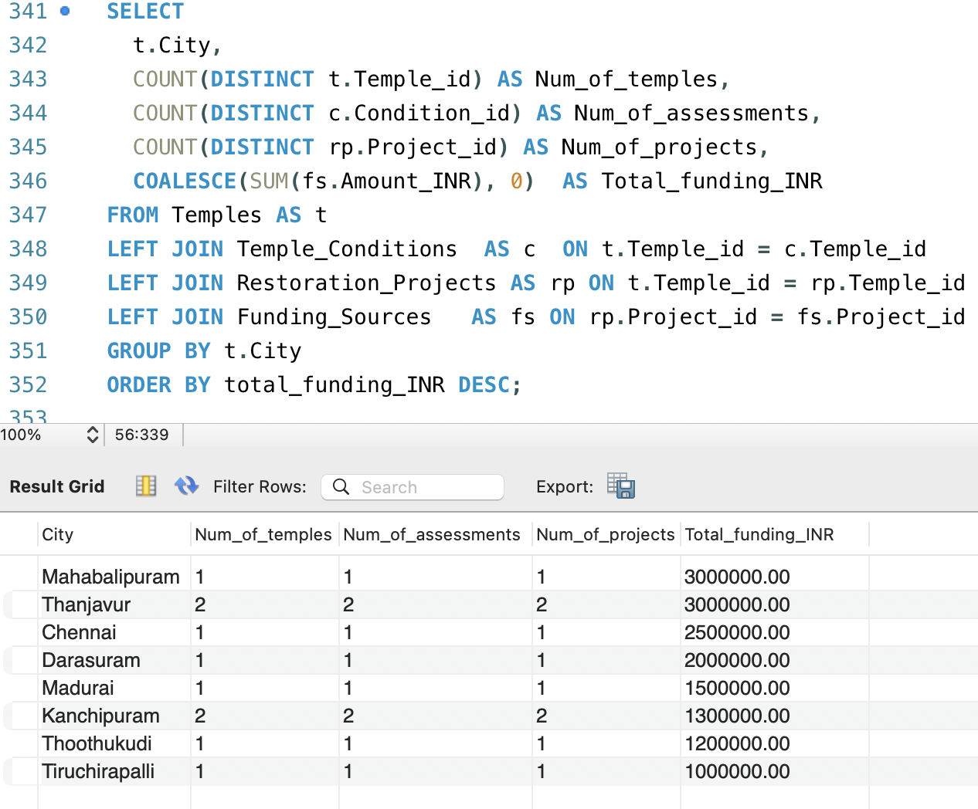
2. For each city, report how many temples, assessments, projects, and the total funding, ordering cities by descending funding.
SELECT
t.City,
COUNT(DISTINCT t.Temple_id) AS Num_of_temples,
COUNT(DISTINCT c.Condition_id) AS Num_of_assessments,
COUNT(DISTINCT rp.Project_id) AS Num_of_projects,
COALESCE(SUM(fs.Amount_INR), 0) AS Total_funding_INR
FROM Temples AS t
LEFT JOIN Temple_Conditions AS c ON t.Temple_id = c.Temple_id
LEFT JOIN Restoration_Projects AS rp ON t.Temple_id = rp.Temple_id
LEFT JOIN Funding_Sources AS fs ON rp.Project_id = fs.Project_id
GROUP BY t.City
ORDER BY Total_funding_INR DESC;
Explanation:
This query groups data by city, showing the number of temples, assessments, projects, and total funding for each city. It uses 4 WAY LEFT JOIN to include all cities, even if some temples don't have assessments, projects, or funding. The results are sorted by the total funding in descending order.
Advanced SQL Queries

Slide 39
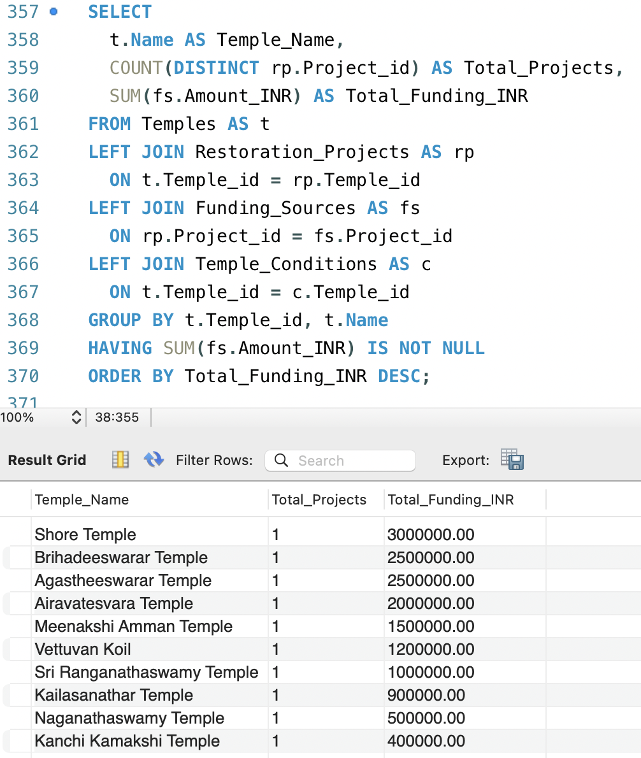
3. List each temple’s name, the total number of restoration projects it has, and the total funding amount received.
SELECT
t.Name AS Temple_Name,
COUNT(DISTINCT rp.Project_id) AS Total_Projects,
SUM(fs.Amount_INR) AS Total_Funding_INR
FROM Temples AS t
LEFT JOIN Restoration_Projects AS rp
ON t.Temple_id = rp.Temple_id
LEFT JOIN Funding_Sources AS fs
ON rp.Project_id = fs.Project_id
LEFT JOIN Temple_Conditions AS c
ON t.Temple_id = c.Temple_id
GROUP BY t.Temple_id, t.Name
HAVING SUM(fs.Amount_INR) IS NOT NULL
ORDER BY Total_Funding_INR DESC;
Explanation:
This query groups data by temple, showing the total number of projects and total funding for each temple. It uses 3 WAY LEFT JOIN to include all temples data from all the associated tables. Each temple’s Total funding total funding in descending order.
Advanced SQL Queries

Slide 40
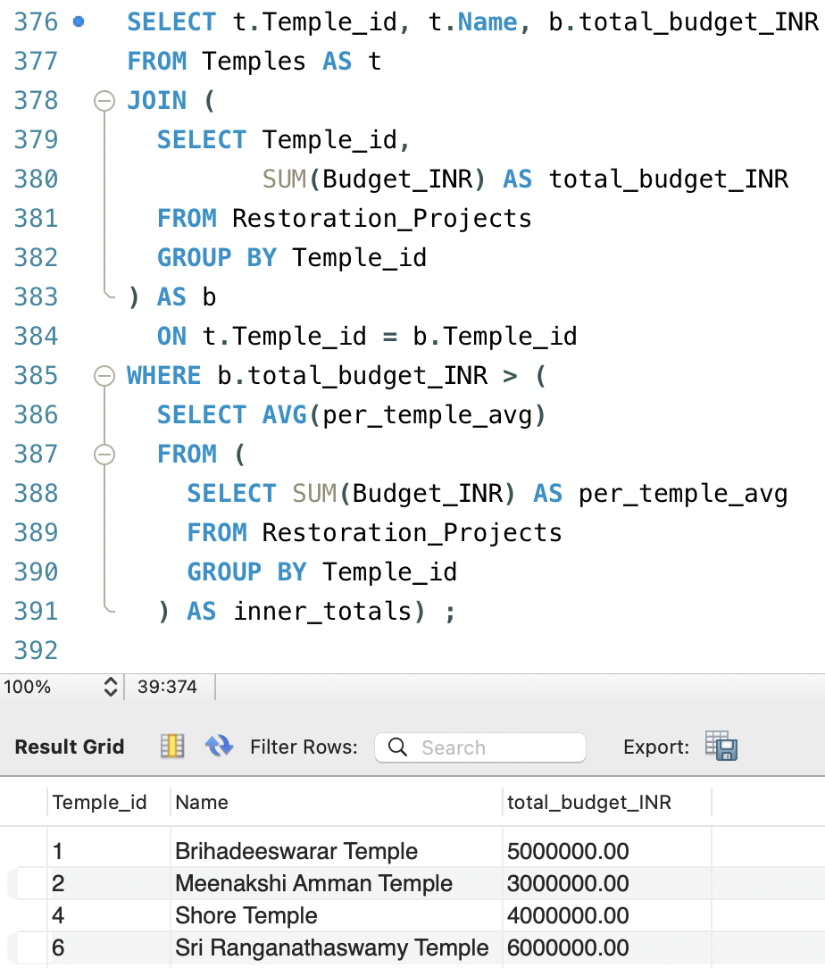
4. List temples whose total restoration budget exceeds the average total budget per temple.
SELECT t.Temple_id, t.Name, b.total_budget_INR
FROM Temples AS t
JOIN (
SELECT Temple_id,
SUM(Budget_INR) AS total_budget_INR
FROM Restoration_Projects
GROUP BY Temple_id
) AS b
ON t.Temple_id = b.Temple_id
WHERE b.total_budget_INR > (
SELECT AVG(per_temple_avg)
FROM (
SELECT SUM(Budget_INR) AS per_temple_avg
FROM Restoration_Projects
GROUP BY Temple_id
) AS inner_totals) ;
Explanation:
Innermost subquery calculates the total budget per temple. Second subquery gets the average total budget across all temples. Outer query joins the temples with their total budget and filters to include only those temples with a total budget greater than the average.
Advanced SQL Queries

Slide 41
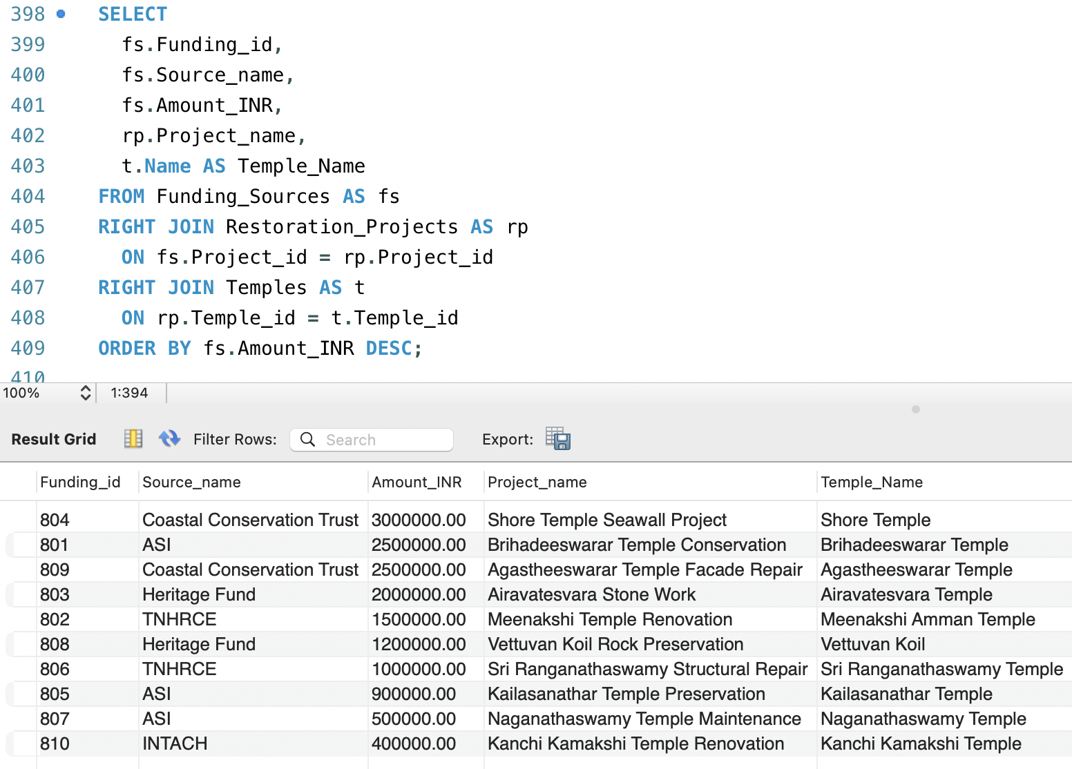
5. List all funding sources their associated restoration projects and temple names, ordered by funding amount descending.
SELECT
fs.Funding_id,
fs.Source_name,
fs.Amount_INR,
rp.Project_name,
t.Name AS Temple_Name
FROM Funding_Sources AS fs
RIGHT JOIN Restoration_Projects AS rp
ON fs.Project_id = rp.Project_id
RIGHT JOIN Temples AS t
ON rp.Temple_id = t.Temple_id
ORDER BY fs.Amount_INR DESC;
Explanation:
This query lists funding details along with the project and temple names, using 3 WAY RIGHT JOIN to ensure all restoration projects and temples are included. It sorts the funding amount in descending order, showing the largest funding amounts first.
Advanced SQL Queries

Slide 42

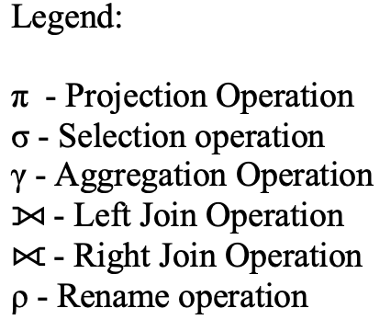
Basic Mathematical Notation
Lists the temples data that start with “T” in their city name but not UNESCO heritage.
πTemple_id, Name,City, Heritage_status​
(σCity LIKE ′ T%′ ∧ Heritage_status ′UNESCO′​(Temples))
Explanation:
σ (Sigma) selects only those temples that has city starting with letter “T” but not a part UNESCO heritage site. π (Pi) projects only columns Temple_id, Name,City, Heritage_status​ from the Temples table.

Slide 43
Basic Mathematical Notation
2. List the projects that are ongoing with a high budget or funded by ASI.
πProject_id, Project_name, Status, Budget_INR →Budget_in_INR , Responsible_agency ( σ(Status=′Ongoing′∧ Budget_INR > 2000000) ∨ (Responsible_agency=′ASI′)​(Restoration_Project))
Explanation:
σ selects only those restoration projects that are either ongoing with a budget greater than 20,00,000 INR or are handled by the ASI. π filters only the columns Project_id, Project_name, Status, Budget (renamed as Budget_in_INR), and Responsible_agency from the Restoration_Projects table.

Slide 44
Basic Mathematical Notation
3. Lists the funding sources with the total contributions over 1,000,000 INR in descending order.
πSource_name, COUNT(*)→Number_of_funding,
SUM(Amount_INR)→Total_amount_in_INR​ (σ_{SUM(Amount_INR)>1000000}​ (_{Source_name} γ_{COUNT(*), SUM(Amount_INR)​}
(Funding_Sources)))
Explanation:
γ (Gamma) groups the Funding_Sources table by Source_name and calculates the count of fundings and total amount funded for each source. σ (Sigma) selects only those sources where the total amount is greater than 10,00,000 INR. π (Pi) filters the columns Source_name,Number_of_funding (COUNT), and Total_amount_in_INR (SUM) from the filtered result.

Slide 45
4. Lists the funding sources after 2023-01-01 and with amounts greater than 2,000,000 INR.
πFunding_id, Project_id, Source_name,
Amount_INR → Amount_in_INR, Funding_date​
(σAmount_INR>2000000 ∨ Funding_date<′2023-01-01′​
(Funding_Sources))
Explanation:
σ (Sigma) selects only those funding records where the amount is greater than 20,00,000 INR or the funding date is before January 1, 2023. π (Pi) projects the columns Funding_id, Project_id, Source_name, Amount (renamed as Amount_in_INR), and Funding_date from the Funding_Sources table.
Basic Mathematical Notation

Slide 46
5. List the temples that have no 'Planned' restoration projects.
π_{t.Temple_id, t.Temples​ ​} (ρ_{t} Temples) − π_{rp.Temple_id​}
(σ_{rp.Status = ′Planned′​} (ρ_{rp} Restoration_Projects))
Explanation:
ρ (Rho) renames the Temples table as t and the Restoration_Projects table as rp for easier reference. σ (Sigma) selects only those restoration projects from rp where the status is 'Planned'. π (Pi) projects the Temple_id from both tables. The − (Set Difference) finds temples from t that do not have any 'Planned' restoration project in rp.
Basic Mathematical Notations

Slide 47
Intermediate Mathematical Notations
List all the temples and show the temple's condition assessments with the date of inspection.
πt.Temple_id, t.Name, c.Condition_date → Date_of_inspection, c.Structural_integrity​ ( ρ_{t}
Temples ⟕​_{t.Temple_id= c.Temple_id}
ρ_{c}Temple_Conditions)
Explanation:
ρ (Rho) renames the Temples table as t and the Temple_Conditions table as c for easier reference. ⟕ (Left Join) combines all temples from t with matching condition records from c based on Temple_id. π (Pi) projects the columns Temple_id, Name, Condition_date (renamed as Date_of_inspection), and Structural_integrity from the joined result.

Slide 48
2. List the name of all stakeholders and the reports submitted by them.(including those with no reports).
πs.Stakeholder_id, s.Name →Stakeholder_Name,
_{r.Report_id, r.Report_date}​
(ρ_{s} Stakeholders ⟖​s.Stakeholder_id=r.Stakeholder_id
ρ_{r} Stakeholder_Reports)
Explanation:
ρ (Rho) renames the Stakeholders table as s and the Stakeholder_Reports table as r for easier reference. ⟖ (Right Join) combines all reports from r with matching stakeholder details from s based on Stakeholder_id. π (Pi) projects the columns Stakeholder_id, Stakeholder_Name (Name from s), Report_id, and Report_date from the joined result.
Intermediate Mathematical Notation

Slide 49
1. List each temple’s name, the total number of restoration projects it has, and the total funding amount received.
πt.Name → Temple_Name, COUNT(DISTINCT Project_id → Total_Projects, SUM(Amount_INR)→Total_Funding_INR (σ_{Total_Funding_INR IS NOT NULL}​ ​( _{Temple_id, Name}
γCOUNT(DISTINCT Project_id), SUM(Amount_INR) ​(((ρ_{t} Temples ⟕​ _{t.Temple_id= rp.Temple_id} ρ_{rp} Restoration_Projects) ⟕ _{rp.Project_id=fs.Project_id}​ ρ_{fs} Funding_Sources) ⟕​ _{fs.Temple_id=c.Temple_id} ρ_{c} Temple_Conditions)))
Explanation:
ρ (Rho) renames the Temples table as t, Restoration_Projects as rp, Funding_Sources as fs, and Temple_Conditions as c for easier reference. ⟕ (Left Outer Joins) are used to combine temples with their related projects, funding sources, and conditions, keeping all temple records even if some details are missing. γ (Gamma) groups by Temple_id and Name and calculates COUNT of distinct Project_id and SUM of Amount for each temple. σ (Sigma) selects only those temples where the Total_Funding is not NULL (i.e., temples that received some funding). π (Pi) finally projects the columns Temple_Name, Total_Projects, and Total_Funding from the grouped and filtered data.
Advanced Mathematical Notation

Slide 50
Conclusion and Future Scope
The designed temple preservation system provides a centralized, structured, and real-time method for managing ancient temple information.
It ensures better monitoring of temple conditions and supports timely and budget-conscious restoration efforts.
Develop a mobile app version for easier public access, volunteer participation, and real-time field reporting.

Slide 51

References
Elmasri & Navathe, Fundamentals of Database Systems (7th Edition).
Official MySQL Documentation – https://dev.mysql.com/doc
https://whc.unesco.org/en/list/
https://hrce.tn.gov.in/hrcehome/templegis_search.php
https://asi.nic.in/

Slide 52
Thank you

